Slide 1
Flight of Insights
Navigating Data Turbulence with SQL Modelling and Visualisation

Slide 2


About Me
10+ years working with IT sector
3 years working with Azure stack
Multiple Microsoft Exams
Outsourcing IT
Networking
MDM

Slide 3
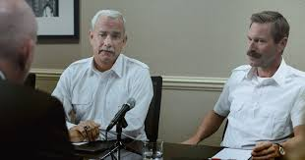

The miracle story
“No one warned us. No one said “You’re going to lose both engines at a lower altitude than any jet in history. But be cool, just make a left turn for LaGuardia like you are going back to pick up the milk.” This was dual engine loss at 2800 feet followed by immediate water landing with 155 souls on board. No one has ever trained for an incident like that. No one.”

Slide 4

Build a foundation
Explore the data
Understand the data
Analyse the data
Include the correct, accurate, and useful information
Develop robust data models
Don’t make assumptions

Slide 5

Navigating uncertainty and real time decisions

Slide 6
Facing skepticism from others?
Keep audiences engaged without losing the technical details
Tell a story
A picture is worth a thousand words
Have the right people in the room

Slide 7

Data is King, Visualisation is Queen
Data is the foundation of a visualisation
Data comes first
Visualisation answers the question
Sales forecast for the year
1.56 Million

Slide 8

How do we prepare for the unthinkable?

Slide 9

Feedback Link

